Slide 1
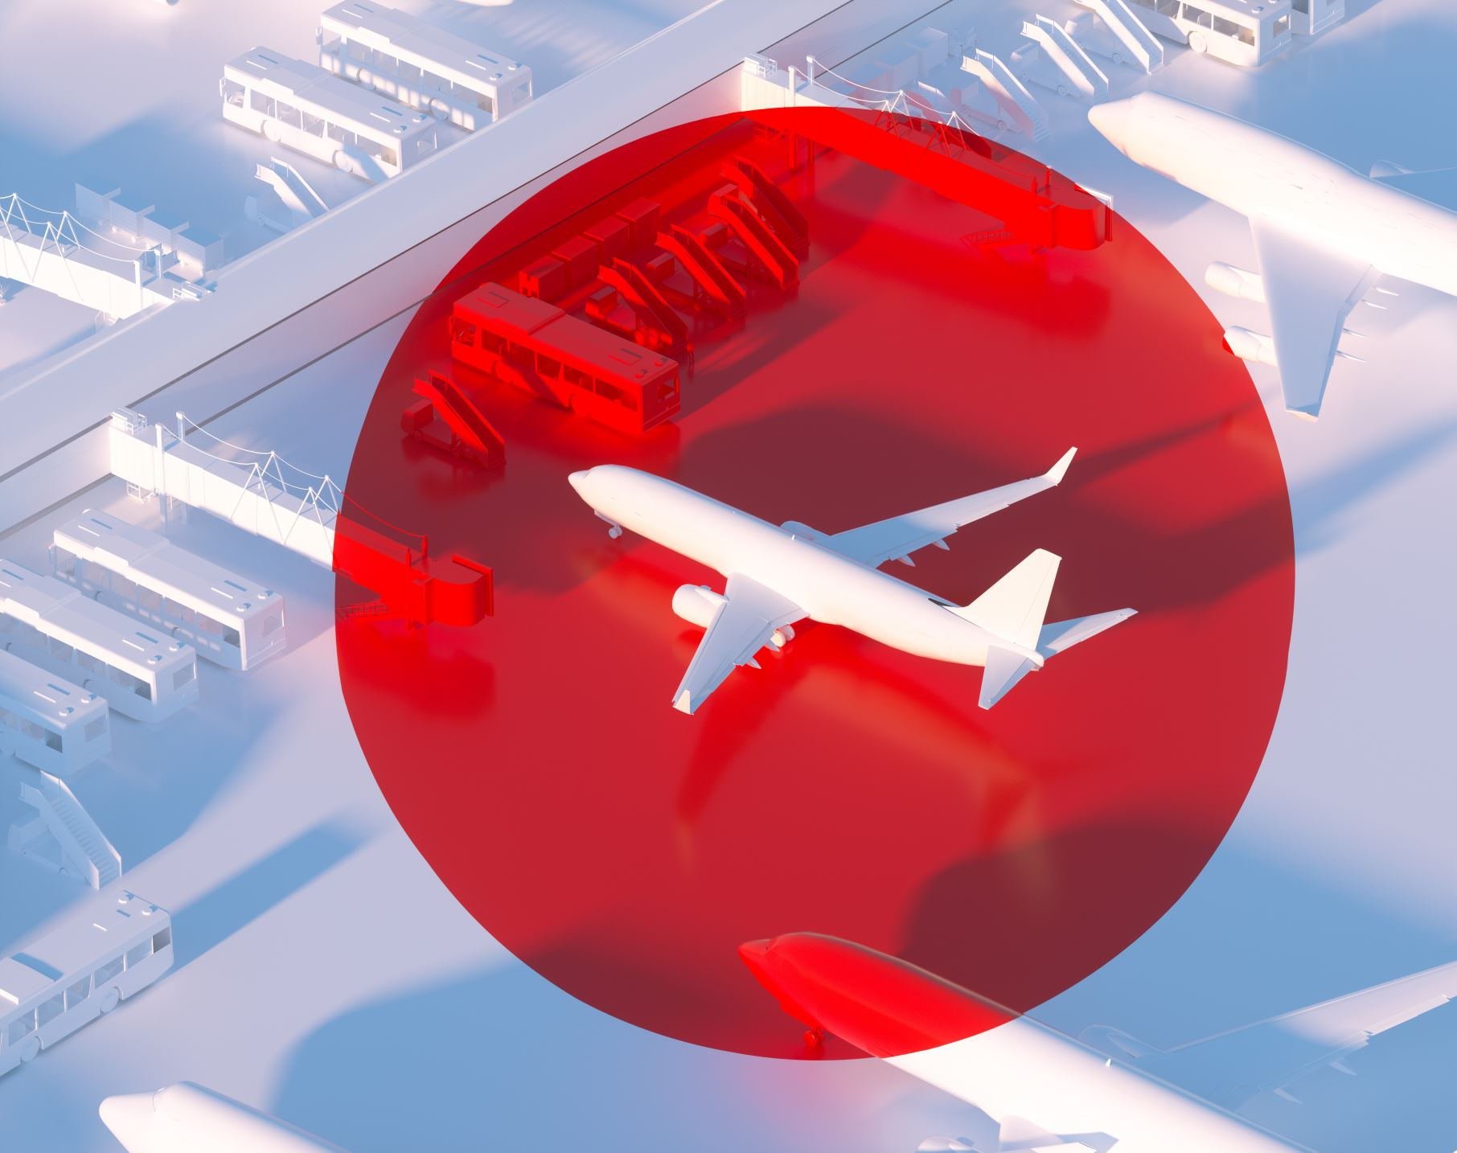
British Airways Customer Review Analysis
Protima Tarafdar

Slide 2

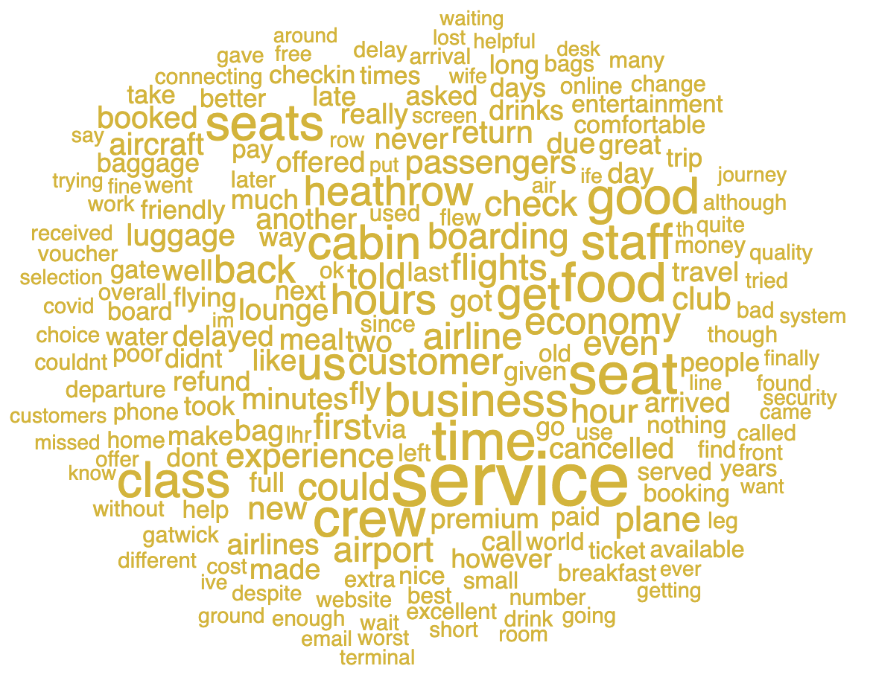
While the reviews have a mix of positive, negative, and neutral sentiments, the hot topic that customers are talking about regarding BA is –
Service, seats, crew, staff, cabin, and time.

